Slide 1
TRACK1_APPLIED_CC_FOR_SOFTWARE_DEPLOYMENT E-COMMERCE (T-SHIRT FACTORY)
Presented by:
1. KONDURU HARI PRASAD RAJU – 20RU1A0526
2. CHALAMKOTI SURESH – 20RU1A0510
3. KOPPULA KRISHNA VENI – 20RU1A0527
4. VENNAPUSA HARITHA – 21RU5A0413
Hrishikesh Mahure
Guided By
Edunet Foundation

Slide 2
OUTLINE
Abstract
Introduction
Industry Overview
Architecture
Technical Resources
Implementation & Desigining
Result
Conclusion
Future Scope
Project Link

Slide 4
INTRODUCTION
Founded in 1853 by Bavarian immigrant Levi Strauss, Levi Strauss& Co. (LS&CO.) is one of the world's largest brand-name apparel marketers with sales in more than 100 countries.
There is no other company with a comparable global presence in the jeans and casual pants markets. Their market-leading apparel products are sold under the Leviss, Dockers) and Levi Strauss Signature brands.
Today, the Levi's trademark is one of the most recognized in the world and is registered in more than 160 countries.
Levi Strauss & Co, is a worldwide corporation organized into three geographic divisions: Levi Strauss, the Americas (LSA), based in the San Francisco headquarters Levi Strauss Europe, Middle East, and Africa (LSEMA), based in Brussels Asia Pacific Division (APD).

Slide 5
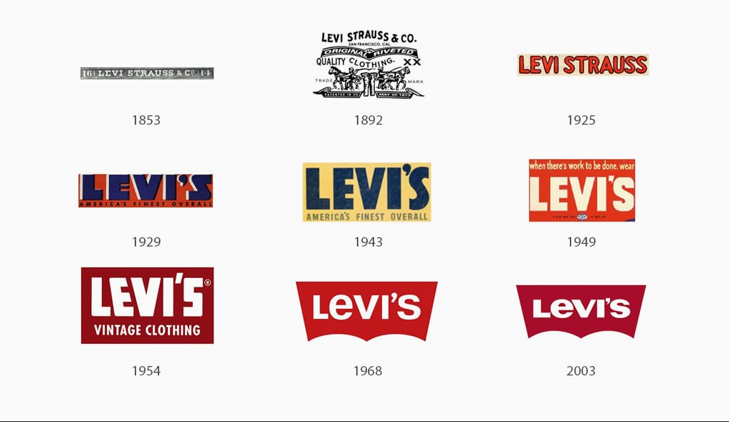

Slide 6
INDUSTRY OVERVIEW
Market Size and Growth
The e-commerce t-shirt industry has experienced substantial growth in recent years. Factors contributing to this growth include the rise of online shopping, customization options, and the increasing popularity of graphic and statement t-shirts. The COVID-19 pandemic also accelerated the shift toward online shopping, benefiting e-commerce businesses, including those specializing in t-shirts.
Future Outlook
The e-commerce t-shirt industry is likely to continue evolving, with a focus on personalization, sustainability, and innovative marketing strategies. As e-commerce technologies advance, t-shirt websites will need to adapt to changing consumer preferences and market dynamics to remain competitive. Keeping an eye on trends and continuously engaging with customers will be key to long-term success in this sector.

Slide 7
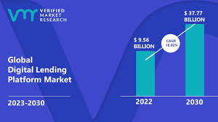
.

Slide 8
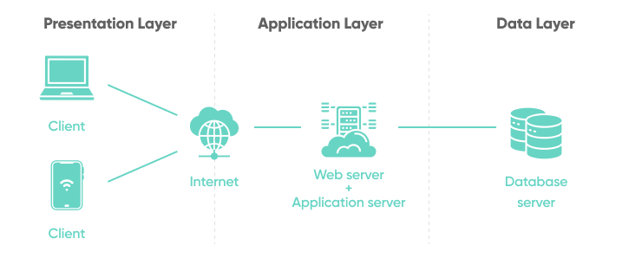
ARCHITECTURE

Slide 9
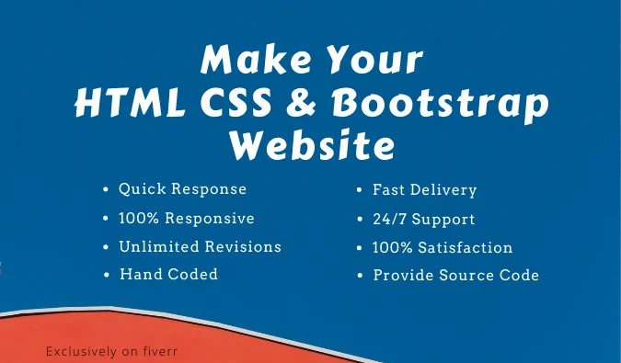
TECHNICAL RESOURCES

Slide 10

HTML
HTML (Hypertext Markup Language) is a fundamental language used for creating web pages. It provides the structure and formatting for content on the World Wide Web
It is used for:
Creating web pages
Text formatting
Adding links
Insert images & Multi Media
Creating forms & Tables

Slide 11

CSS
Cascading Style Sheets (CSS) is a crucial technology in web development that is used to control the presentation and styling of web pages. CSS provides a way to separate the structure (HTML) from the visual presentation, allowing for greater design flexibility and maintainability.
It is used for:
Styling web content
Background & Images
Borders and Box effects
Pseudo-classes & Pseudo-Elements
Print Styles
Layout control

Slide 12
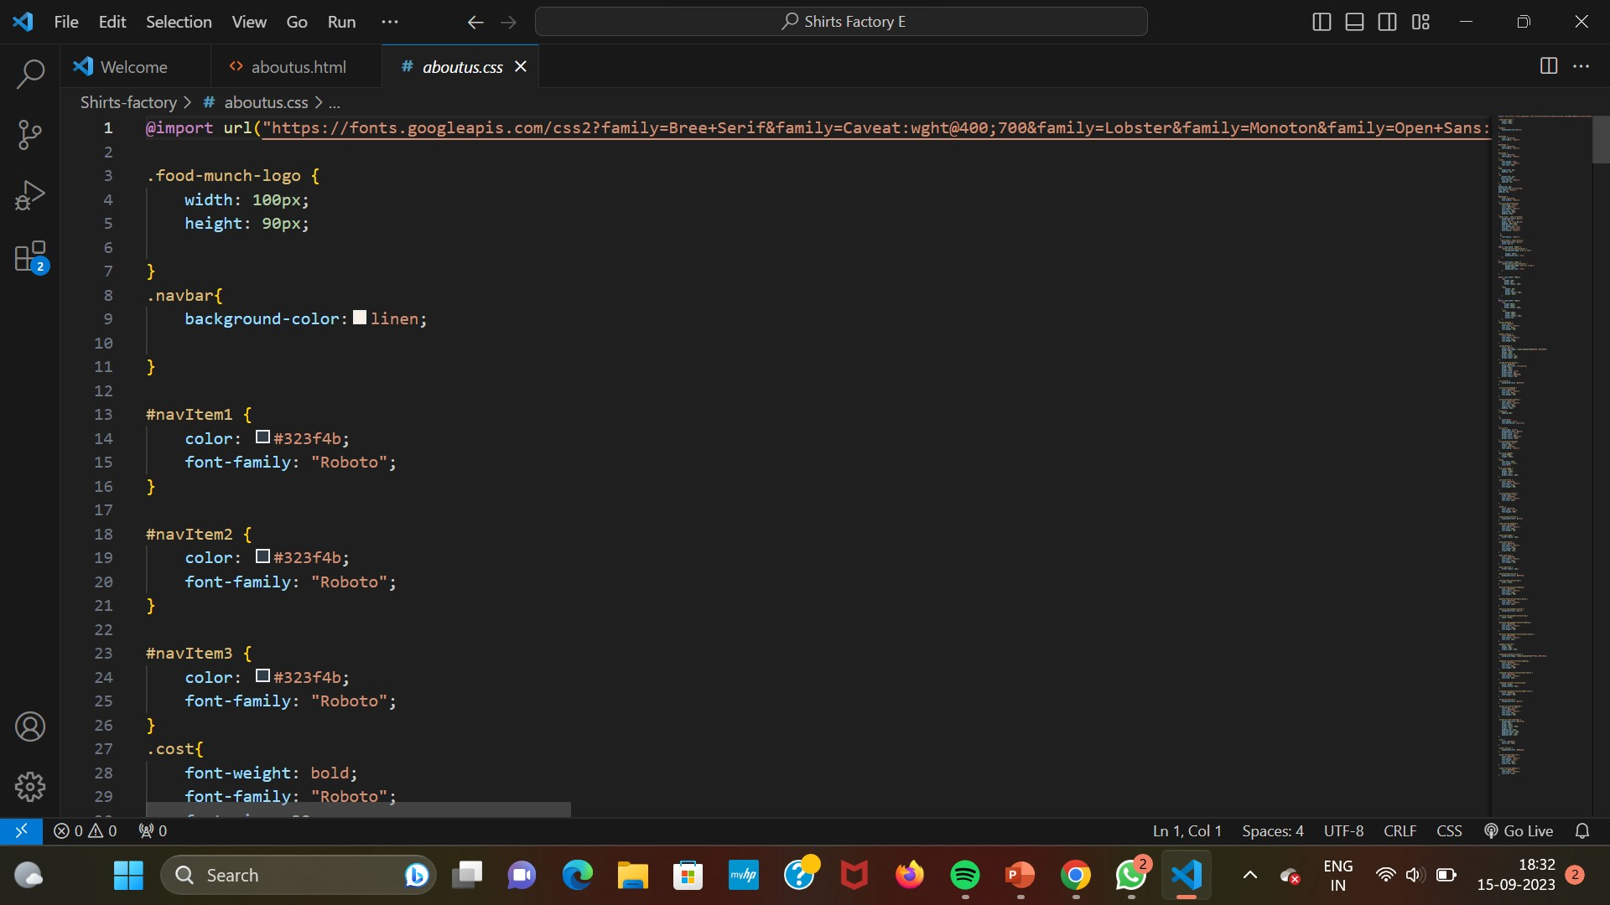
IMPLEMENTATION & DESIGINING

Slide 13
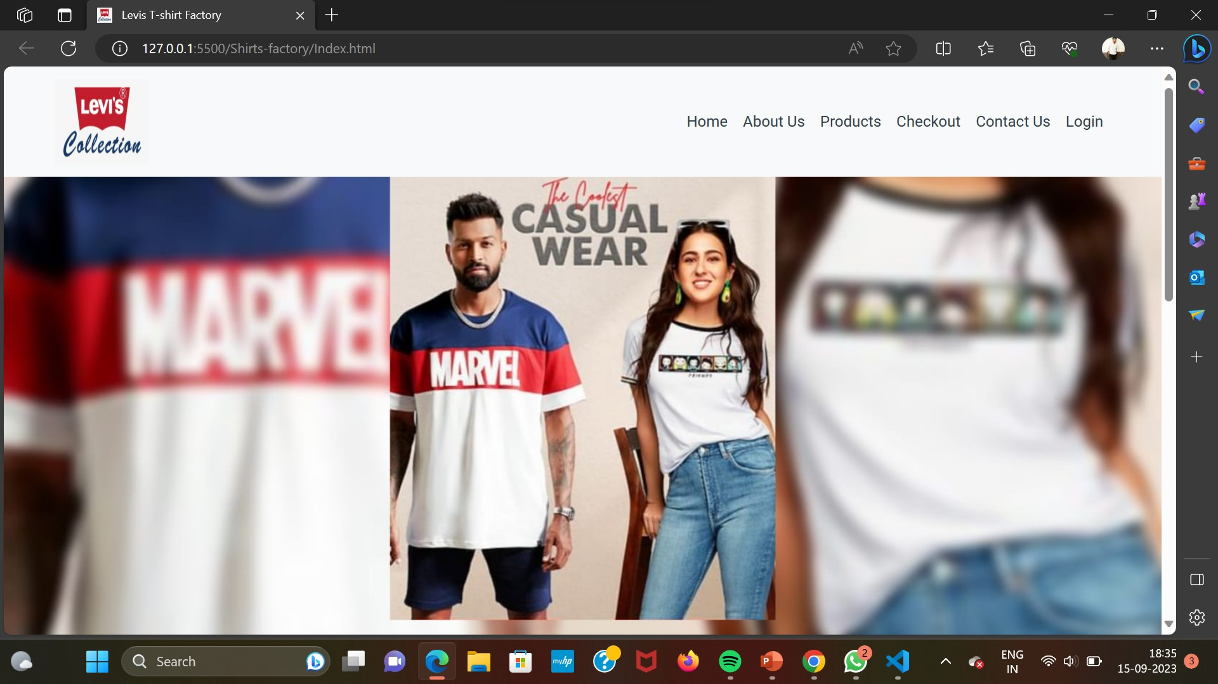
RESULT

Slide 14
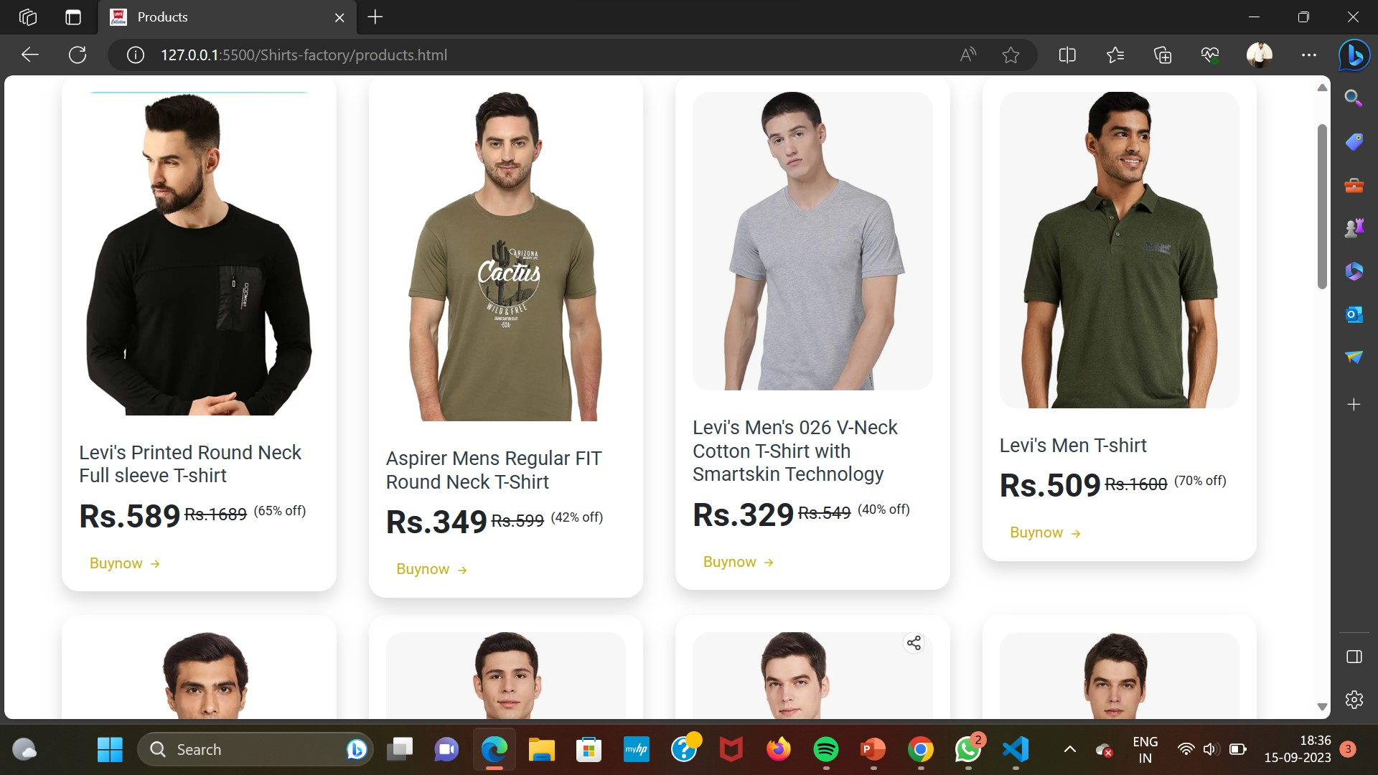
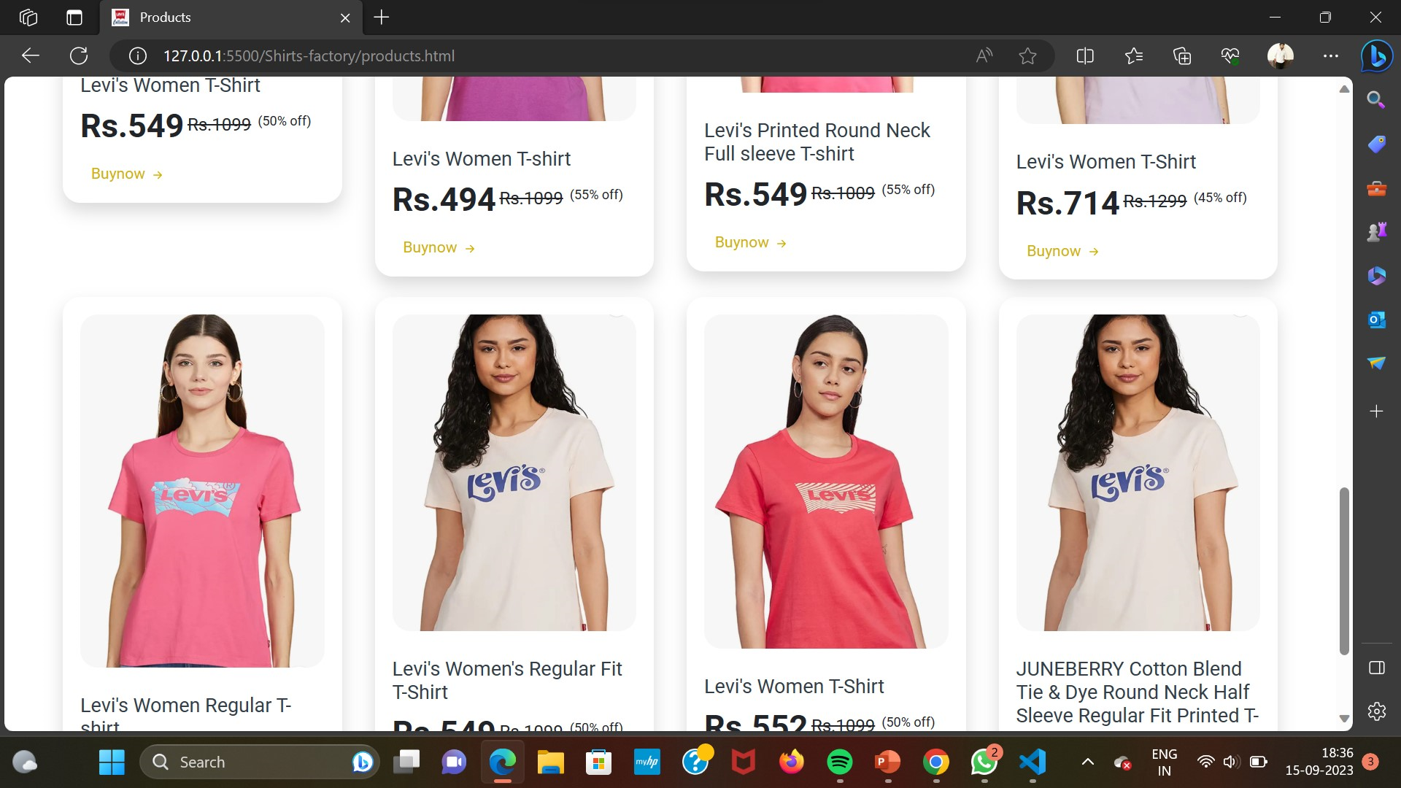
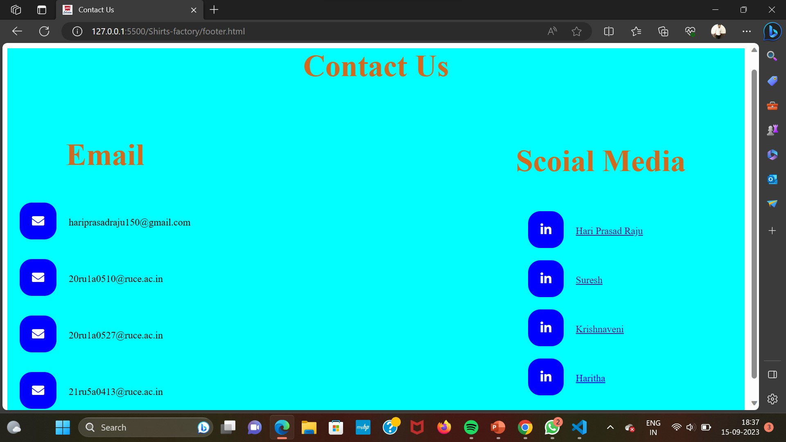
.

Slide 17
PROJECT LINK
https://team-hari-edunetproject.netlify.app/

Slide 18
THANK YOU

